Slide 1
Stream Max
Business Overview

Slide 2
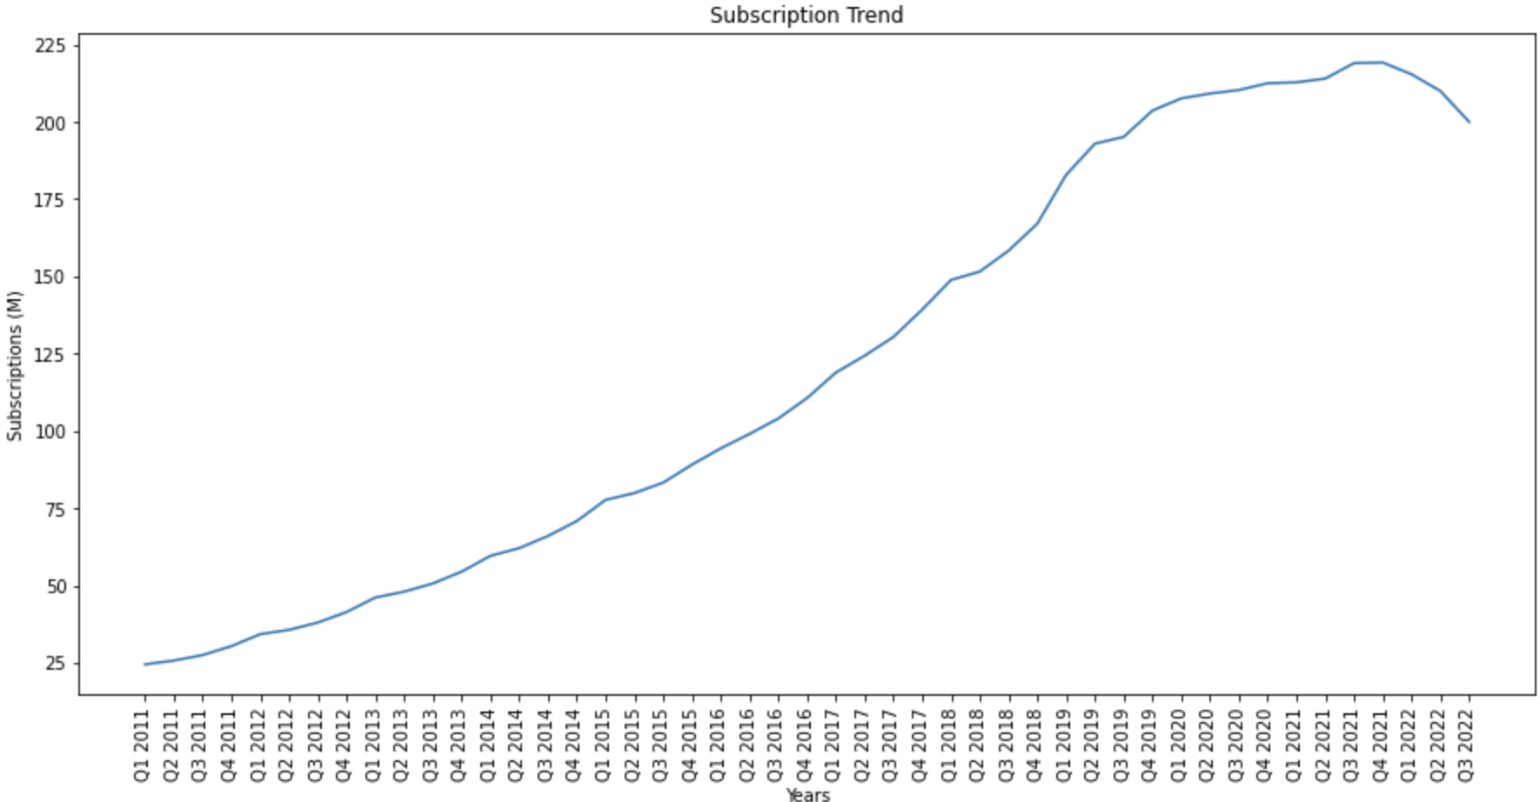
Company Background and Problem Statement
Stream Max is one of the most popular streaming services in the US
Over the past 6 quarters, Stream Max subscription rates have remained stagnant or decreased
Stream Max is looking to identify why subscribers are leaving the platform, and find ways that they can retain their subscribers

Slide 3
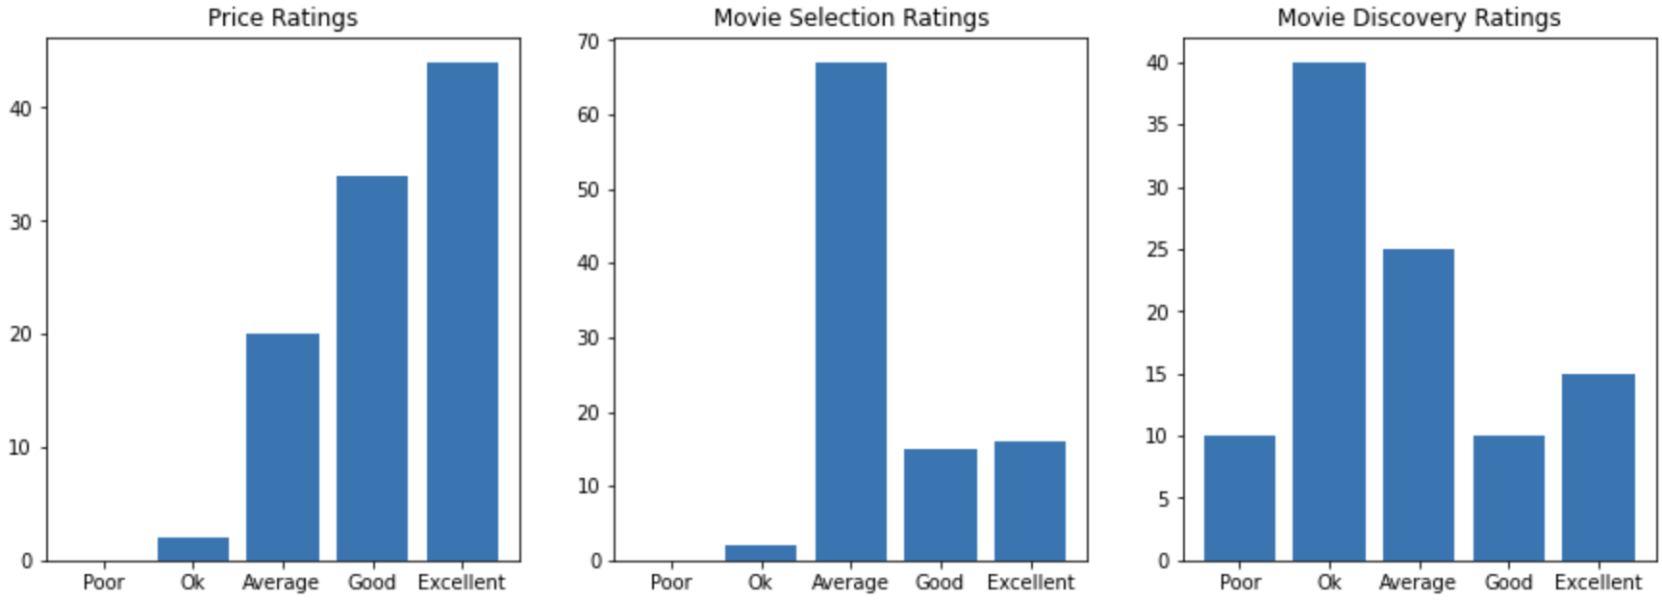
Understanding Customer Feedback
Customer Exit Survey
Survey results showed that most Stream Max customers were satisfied with pricing but found the movie selection was average, and that the platform’s suggestions were only rated “ok”
Stream Max requested their data science team to assist them in building a new recommender system, and also to help them identify films that the streaming platform can purchase to add to their platforms which customers would be satisfied with

Slide 4
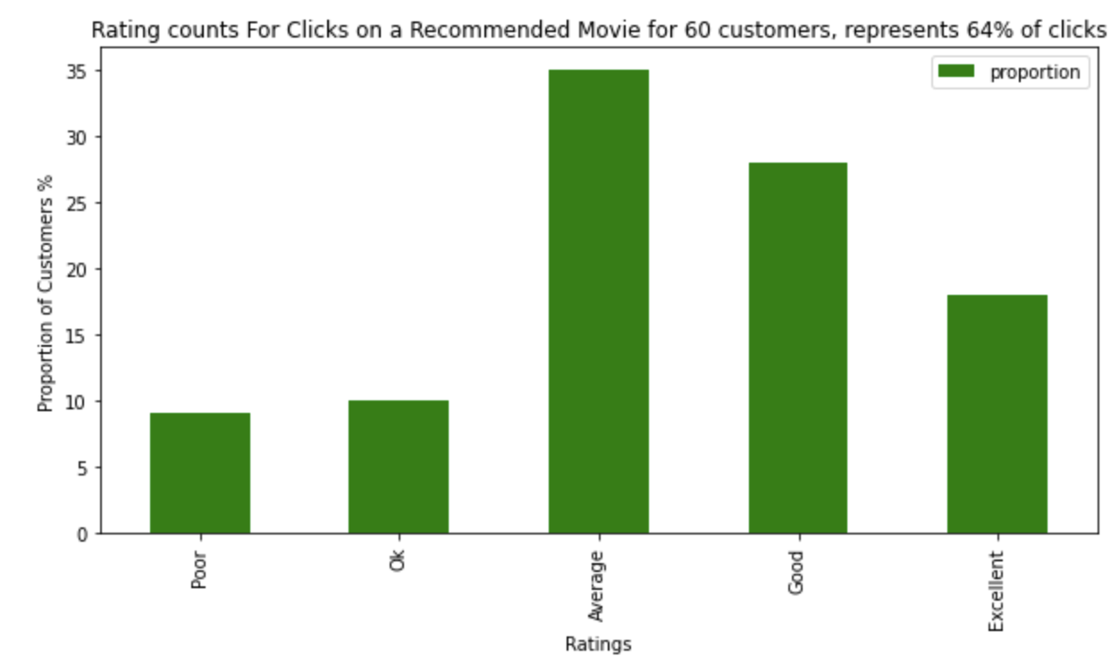
Providing Film Recommendations
Launched Stream Max Discover, a personalized film recommendation system
Provided users with personalized film recommendations based on films that they have previously watched
A/B testing of the new recommendation system shows high satisfaction in recommended films

Slide 5

Identifying Top Quality Films
Launched Stream Max Project X, an internal tool to predict what would be the average user rating of a film on Stream Max’s platform
Trained using data from current Stream Max films, but can be used to predict ratings for new movies
Various features were considered including but not limited to the cast, genre, director, production company, popularity, and box office revenue

Slide 6
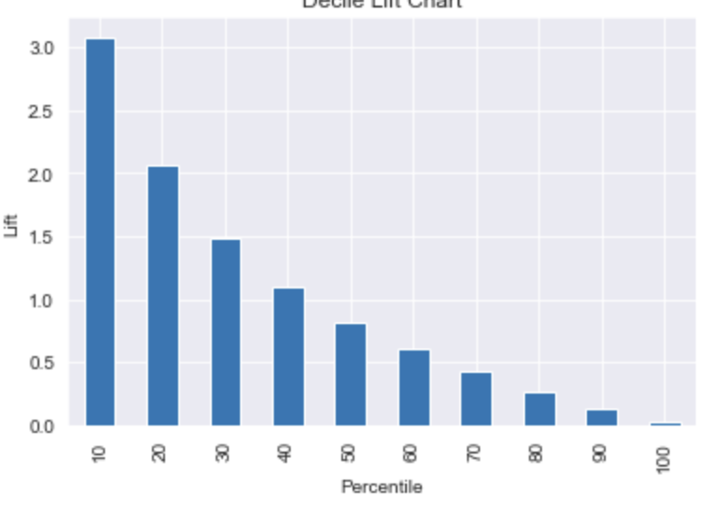
Stream Max in Action
Testing with existing Stream Max films, the prediction model was able to accurately predict customer ratings for 76% of films
Identified 307 potential movies which would be 3X as likely to be highly rated
Identified 615 movies which would be 2X as likely to be highly rated
Movie Quality Lift Chart

Slide 7

Recommendations For the Future
Continue to collect customer survey results to identify other areas where the Stream Max platform can improve
Implement feedback system to measure customer satisfaction of Stream Max Discover
Automate Stream Max Project X pipeline to automate results in realtime

Slide 8

THANKS!
GitHub:
https://github.com/ivan-usd/business-repo

Slide 9
References
Cebrian, J. (2022, April 22). Prediction, anticipation and influence: The importance of AI and machine learning in Loyalty Programs. MarTech. Retrieved October 15, 2022, from https://martech.org/prediction-anticipation-and-influence-the-importance-of-ai-and-machine-learning-in-loyalty-programs/
Michael Galarnyk, cnvrg.io. (2022, May 22). Why some recommendations Fall flat: Recommendation engines & their challenges. VentureBeat. Retrieved October 15, 2022, from https://venturebeat.com/datadecisionmakers/why-some-recommendations-fall-flat-recommendation-engines-their-challenges/
Shmueli, G., Bruce, P. C., Gedeck, P., & Patel, N. R. (2020). Data mining for business analytics: Concepts, techniques and applications in Python. Wiley.
Qutbuddin, M. (2020, October 2). Comprehensive guide on Item Based Recommendation Systems. Medium. Retrieved October 15, 2022, from https://towardsdatascience.com/comprehensive-guide-on-item-based-recommendation-systems-d67e40e2b75d

